Slide 1
Session 4
PHP & MySQL

Slide 2
PHP MySQL Introduction
What is MySQL?
MySQL is a database. A database defines a structure for storing information.
In a database, there are tables. Just like HTML tables, database tables contain rows, columns, and cells.
Databases are useful when storing information categorically. A company may have a database with the following tables: "Employees", "Products", "Customers" and "Orders".

Slide 3
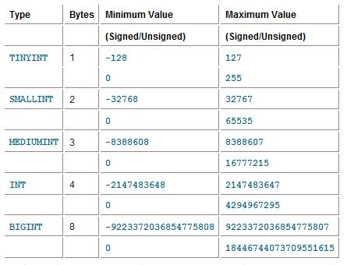
MySQL Data Types
Numeric Types

Slide 4
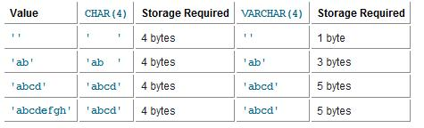
MySQL Data Types
Char and Varchar

Slide 5
MySQL Data Types
Date Time
DATE() A date. Format: YYYY-MM-DD
Note: The supported range is from '1000-01-01' to '9999-12-31‘
DATETIME() *A date and time combination. Format: YYYY-MM-DD HH:MM:SS
Note: The supported range is from '1000-01-01 00:00:00' to '9999-12-31 23:59:59‘
TIME() A time. Format: HH:MM:SS
Note: The supported range is from '-838:59:59' to '838:59:59‘
YEAR() A year in two-digit or four-digit format.
Note: Values allowed in four-digit format: 1901 to 2155. Values allowed in two-digit format: 70 to 69, representing years from 1970 to 2069

Slide 6
Primary Keys and Auto Increment Fields
A primary key is used to uniquely identify the rows in a table. Each primary key value must be unique within the table. Furthermore, the primary key field cannot be null because the database engine requires a value to locate the record.
AUTO_INCREMENT automatically increases the value of the field by 1 each time a new record is added. To ensure that the primary key field cannot be null, we must add the NOT NULL setting to the field.
Sample SQL in MySQL like that:
CREATE TABLE Persons (
personID int NOT NULL AUTO_INCREMENT,
PRIMARY KEY(personID),
FirstName varchar(15),
LastName varchar(15), Age int )

Slide 7
Connect to a Database
Before you can access and work with data in a database, you must create a connection to the database.
mysql_connect(servername,username,password);
Parameter Description
servername Optional. Specifies the server to connect to. Default value is "localhost:3306"
username Optional. Specifies the username to log in with. Default value is the name of the user that owns the server process
Password Optional. Specifies the password to log in with. Default is "
<?
$con = mysql_connect("localhost","peter","abc123");
if (!$con) {
die('Could not connect: ' . mysql_error());
}
// some code ?>

Slide 8
Connect to a Database Cont…
Because we access database many times, so we should put connect database into one file and when we need to connect database, we will require its.
In this sample, we make connect.php like this:
And require:
<?
    $con = mysql_connect("localhost","root","1234567") or die("Error connect");
    mysql_select_db("abc") or die("No database");
    // some code
    ?>
<?
require(“connect.php”);
// some code
?>

Slide 9
Closing a Connection
The connection will be closed as soon as the script ends. To close the connection before, use the mysql_close() function.
<?
require(“connect.php”);
if (!$con)
{
die('Could not connect: ' . mysql_error());
} // some code
mysql_close($con);
?>

Slide 10
MySQL Create Database and Tables
Create a Database
The CREATE DATABASE statement is used to create a database in MySQL.
<?
  require(“connect.php”);
  if (mysql_query("CREATE DATABASE my_db",$con))
  {
  echo "Database created";
  }
  mysql_close($con);
?>

Slide 11
MySQL Create Database and Tables
When you want to create table, you must select database using:
  mysql_select_db(“database name“ [, $con]);
The CREATE TABLE statement is used to create database table in MySQL.
<?
  require(“connect.php”);
  mysql_select_db("my_db", $con);
  $sql = "CREATE TABLE Persons ( FirstName varchar(15), LastName varchar(15), Age int )";
  // Execute query
  mysql_query($sql,$con);
  mysql_close($con);
?>

Slide 12
Execute Query in Mysql
Statement:
  mysql_query(“SQL statement” [,connection]);
    SQL statement is SQL like insert, update, delete, select, create……
    Connection is connect string to connect database
Sample:
  mysql_query(“select * from Category”);

Slide 13
MySQL Select
The SELECT statement is used to select data from a database.
mysql_fetch_array() function returns a row from a recordset as an associative array and/or a numeric array.
This function gets a row from the mysql_query() function and returns an array on success, or FALSE on failure or when there are no more rows.
<? require("connect.php");
  $sql="select * from Category";
  $result=mysql_query($sql) or die("Error!");
  while ($row=mysql_fetch_array($result)){
  echo "<tr><td>".$row["catid"]."</td>";
  echo "<td>".$row["catname"]."</td>";
  echo "<td><img width=80 src='images/".$row["catimage"]."'></td></tr>";
  }
  mysql_close($con);
?>

Slide 14
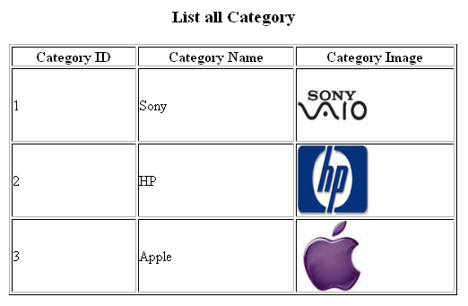
MySQL Select Cont…
Results:

Slide 15
MySQL Insert
The INSERT INTO statement is used to insert new records into a database table.
<?
require(“connect.php”);
mysql_query("INSERT INTO Persons (FirstName, LastName, Age) VALUES ('Peter', 'Griffin', 35)");
mysql_close($con);
?>

Slide 16
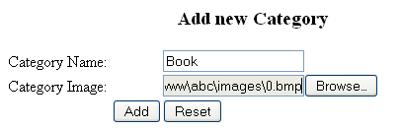
MySQL Insert Cont…
Sample form
<?
require("connect.php");
$name=$_POST["txtName"];
$image=$_POST["txtImage"];
$sql = "insert into Category(catname, catimage) values ('{$name}','{$image}')";
mysql_query($sql) or die("Error: ".$sql);
echo "<script>window.location='view.php';</script>";
?>

Slide 17
MySQL Update
The UPDATE statement is used to modify data in a database table.
<?
require(“connect.php”);
mysql_query("UPDATE Persons SET Age = '36' WHERE FirstName = 'Peter' AND LastName = 'Griffin'");
mysql_close($con);
?>

Slide 18
MySQL Delete From
The DELETE FROM statement is used to delete rows from a database table.
Sample delete.php file:
<?
require(“connect.php”);
mysql_query("DELETE FROM Persons WHERE LastName='Griffin'");
mysql_close($con);
?>
<?
require("connect.php");
$catid=$_GET["catid"];
$sql = "delete from Category where catid=".$catid;
mysql_query($sql) or die("Error: ".$sql);
echo "<script>window.location='view.php';</script>";
?>

Slide 19
Unicode with PHP & MySQL
Create a database with collation is utf8_unicode_ci
Execute “ mysql_query("SET NAMES 'UTF8'"); ” command after connecting to this database.
Set charset=utf-8 for all webpages.

